Slide 1
Introduction to React
Ankush IT-16, Abhay IT-02, Anurag IT-18

Slide 2


What is React?
React is a JavaScript Library
Used for front end web development
Created and used by Facebook
Famous for implementing a virtual DOM

Slide 3









Timeline of front-end JavaScript frameworks
jQuery*
(2006)
AngularJS
(2010)
React
(2013)
Vue
(2014)
Angular
(2014)
* jQuery is more often considered a library than a framework

Slide 4
Fundamentals of React
JavaScript and HTML in the same file (JSX)
Embrace functional programming
Components everywhere

Slide 5



JavaScript and HTML in the same file
HTML
CSS
JS
JSX
CSS or JSS
Traditional approach
React approach

Slide 6
JSX: the React programming language
const first = "Aaron"; const last = "Smith";
const name = <span>{first} {last}</span>;
const list = (
<ul>
<li>Dr. David Stotts</li>
<li>{name}</li>
</ul>
);
const listWithTitle = (
<>
<h1>COMP 523</h1>
<ul>
<li>Dr. David Stotts</li>
<li>{name}</li>
</ul>
</>
);

Slide 7
“React is just JavaScript”

Slide 8
Functional programming
Functions are “first class citizens”
Variables are immutable

Slide 9
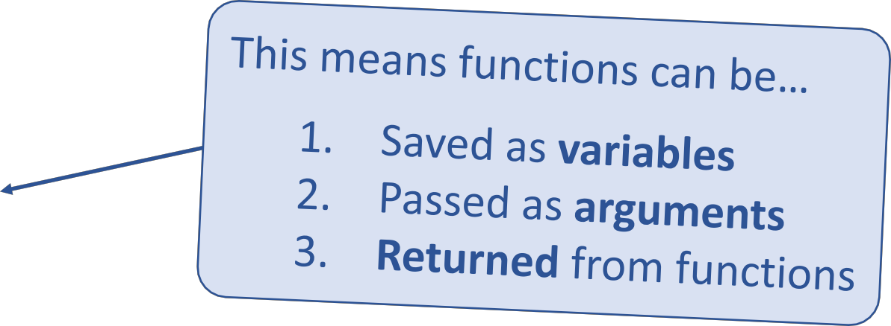
Functional programming
Functions are “first class citizens”
let add = function() { console.log('Now adding numbers'); const five = 3 + 2;
};
function foo() { return function() {
console.log('What gets printed?');
};
}
foo foo(); foo()();
function performTask(task) { task();
console.log('Task performed!');
}
performTask(add);

Slide 10
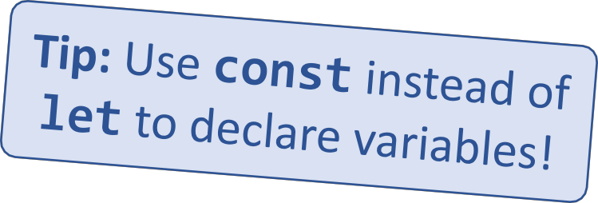
Functional programming
Variables are immutable
let a = 4;
a = 2; // Mutates `a`
let b = [1, 2, 3]; b.push(4); // Mutates `b`
let c = [...b, 4]; // Does not mutate `b`

Slide 11
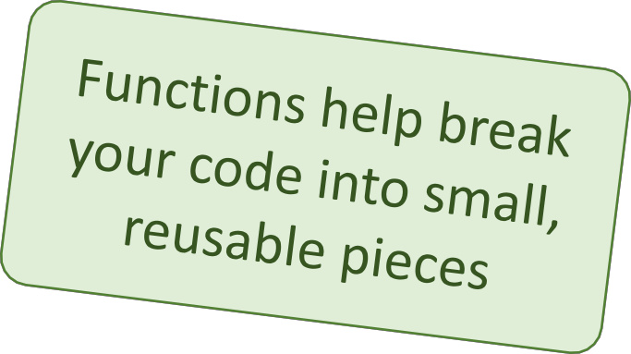


Components
Components are functions for user interfaces
Input x
Output number
Math function:
let y = f(x);
Input x
Output HTML
Component function:
let y = <FancyDiv value={x} />;

Slide 12

Anatomy of a React component
The component is just a function
Inputs are passed through a single argument called “props”
The function outputs HTML
export default function MyComponent(props) {
return <div>Hello, world! My name is {props.name}</div>;
}
const html = <MyComponent name="aaron" />;
The function is executed as if it was an HTML tag
Parameters are passed in as HTML attributes

Slide 13
Component rendering
When a component function executes, we say it “renders”
Assume components may re-render at any time
Our job is to ensure that
every time the component re-renders, the correct output is produced

Slide 14
Creating a new React app
“In React, everything is a component”

Slide 15
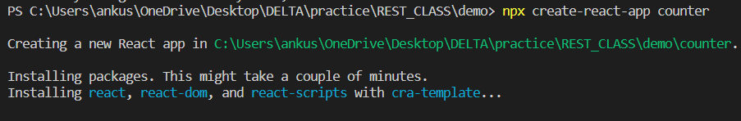
Creating a new React app
Creating a new React app is simple!
1. Install Node.js
2. Run:
npx create-react-app app-name
3. New app created in folder: ./app-name

Slide 16
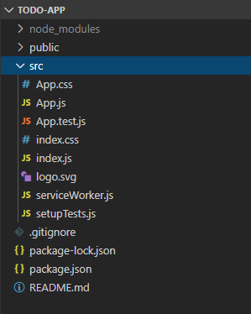
Anatomy of a new React app
public holds the initial html document and other static assets
App is a boilerplate starter component
index.js binds React to the DOM
package.json configures npm dependencies

Slide 17
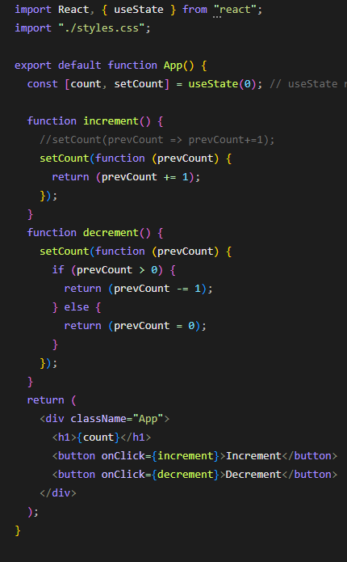

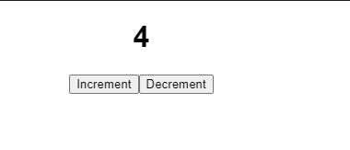
Counter APP
App

Slide 18
What are hooks?
Hooks: Special functions that allow developers to hook into state and lifecycle of React components.
State: One or more data values associated with a React component instance.
Lifecycle: The events associated with a React component instance (create, render, destroy, etc).
Built-in hooks:
useState useEffect
useReducer useMemo useRef useCallback

Slide 19

First React hook: useState
+
Purpose:
Remember values internally when the component re-renders
Tell React to re-render the component when the value changes
Syntax:
const [val, setVal] = useState(100);
The current value
A setter function to change the value
The initial value to use

Slide 20
React-Router
Redux
Material-UI
Bootstrap
Font-Awesome

Slide 21
THANK YOU !

